Slide 1




HEALTHCARE AND WELLNESS
Participant Details:
Team Name: Pheonix Minds
Team Leader Name: Toshan Ranade
Email ID: 20250802675@dypiu.ac.in
Contact No.: 9691011733 , 7888054002
College: D. Y. Patil International University
Team Size: 5
Team Member Names: Krushna Patil, Shalini Arora, Khyati Singh, Shubhi Bhardwaj

Slide 2
THE CORE VISION
The Village Protocol is a holistic healthcare ecosystem designed to restore the "support village" through a hybrid of advanced AI and human empathy. We address the biological, environmental, and social factors that impact Students, Elders, and Women, ensuring the health of the current generation and protecting the genetic integrity of the next.

Slide 3
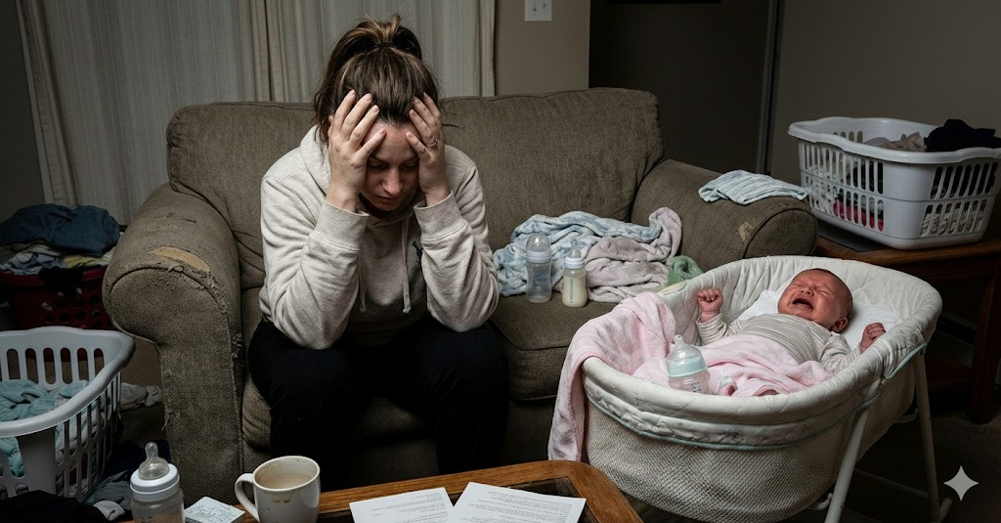
TARGET AUDIENCES: THE THREE PILLARS
Women (Maternal & Intergenerational Health)
Problem: Postpartum Depression (PPD) and environmental stressors that cause epigenetic damage.
The Goal: Reducing maternal cortisol and toxin exposure to prevent the rise of genetic diseases in future generations.
Support: Daily AI check-ins and physical assistance through vetted Midwives and Maternity Maids.

Slide 4

Students (Mental Health & Discretion)
Problem: High stress and depression coupled with a fear of social stigma or institutional records.
The Goal: Providing a "Silent Care" model for those who wish to keep their struggles private.
Support: Discreet home visits in unmarked vehicles and encrypted, anonymous-first AI consultations.

Slide 5
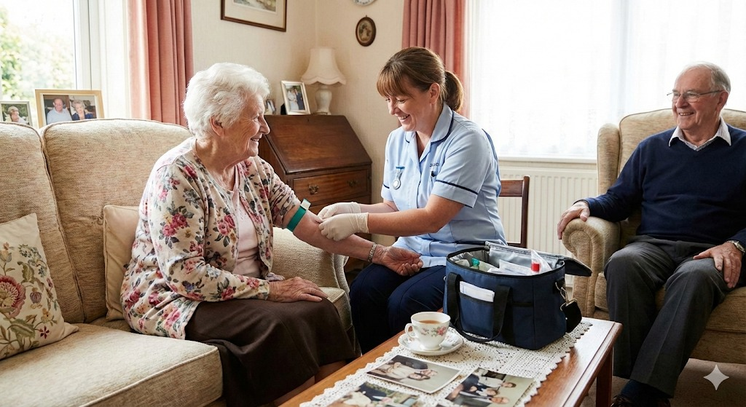
Elders (Longevity & Chronic Care)
Problem: Mobility issues and the danger of isolation.
The Goal: Moving professional medical care from the hospital to the living room.
Support: Regular home-visit check-ups and AI-monitored safety protocols.

Slide 6


THE TECHNOLOGY SOLUTION: "SIDE-BY-SIDE" AI
Our proprietary AI bridge ensures that no patient is ever alone during a medical event.
The Emergency SOS: A one-touch trigger that pings the nearest vetted doctor via GPS, bypassing standard waiting queues.
The Life-Bridge (First Aid): While the doctor is connecting, the AI provides Voice-Guided First Aid and visual loops (GIFs) to the patient or family (e.g., managing a hemorrhage, a fall, or a panic attack).
Synchronous Consultation: Once the doctor joins, the AI stays "side-by-side," providing real-time transcription, medical history summaries, and live translation.
Guardian Mode: Monitors environmental toxins/air quality and sends proactive alerts to protect fetal gene expression.

Slide 7

THE SOCIAL SOLUTION: EMPLOYMENT & VETTING
We solve the healthcare crisis by creating jobs for those in "dire need" and experienced professionals.
Qualified Workforce: We recruit unemployed or underemployed Doctors, Nurses, and Midwives.
The Sentry Vetting Process: 1. Degree Verification: Authenticating all medical credentials. 2. Clinical Audit: Testing empathy and medical skills. 3. Criminal Record Check: Mandatory 6-month background screening.
Two-Way Accountability: A symmetrical rating scheme where patients rate the service, and employees rate the home environment for safety.

Slide 8
THE FAMILY & COMMUNITY PROGRAM
To save the patient, we must educate the "Village."
The Fatherhood Portal: Mandatory modules for men to learn the biology of pregnancy (hormonal drops) and practical childcare skills.
Community Preaching: Programs to dismantle the social stigma of mental health, turning family members into trained "First Responders."

Slide 9
SAFETY & PRIVACY FRAMEWORK
Meeting Codes: A unique "digital handshake" required at the door for every home visit.
Incognito Mode: Unmarked vehicles and civilian clothing for staff to ensure 100% discretion for students and private cases.
Data Kill-Switch: Users can permanently delete their sensitive health history with one tap.
Staff Protection: Wearable panic buttons and "duress codes" to protect healthcare workers in the field.

Slide 10
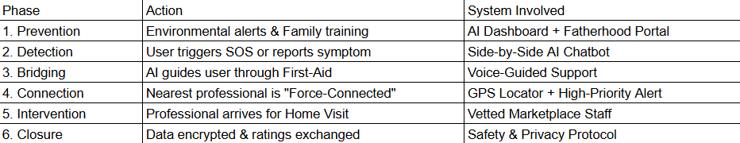
SOLUTION WORKFLOW: HOW IT WORKS

Slide 11
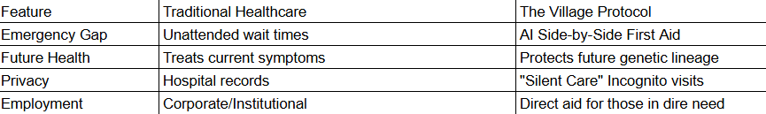
COMPARATIVE IMPACT

